Slide 1

Lead Scoring Case Study by Tabassum Shaikh, Sushant Salunke, Huang-Yin Tso

Slide 2
Problem of Our Study
X Education is an online course provider for industry professionals. The company gets leads from its website, online marketing, and referrals. Visitors on the website can browse courses, watch videos, or fill out a form with their contact details. When they provide contact information, they become leads. The sales team follows up with these leads through calls and emails, but only about 30% of them convert into paying customers.
X Education has a low lead conversion rate. Out of 100 leads, only about 30 become paying customers. The sales team spends a lot of time contacting all leads, including those unlikely to convert. This makes the process inefficient. The company wants to find "Hot Leads"—leads that are more likely to convert—so the sales team can focus on these.

Slide 3

Business Objectives
X Education wants to focus its sales efforts on high-potential leads, known as "Hot Leads," to save time and resources. By identifying these promising leads, the company aims to improve the efficiency of its sales process and avoid spending unnecessary time on low-probability leads.
The goal is to raise the lead conversion rate from the current 30% to 80%. This will result in more paying customers, higher revenue, and better overall performance of the sales and marketing strategies.

Slide 4
Problem Approach
Importing and Merging Data
Inspecting the Dataframe
Data Cleaning and Preparation
Data Visualization
Bivariate and Multivariate Analysis
Creating Dummy Variables
Model Building
Evaluating Our Model
Making Predictions on Test Set

Slide 5
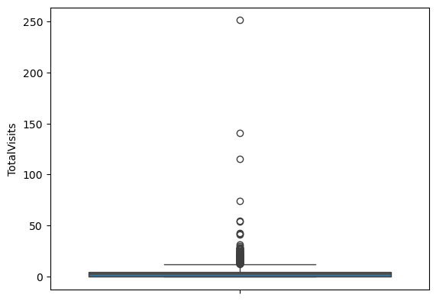
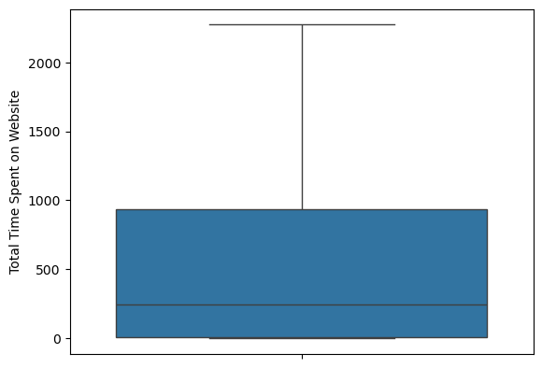
Data Cleaning and Preparation

Slide 6
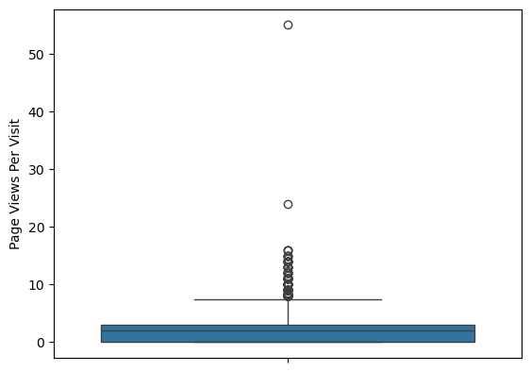
Data Cleaning and Preparation
The three boxplots represent the following:
Page Views Per Visit: This plot shows significant outliers, with most data points clustered below 10. A few extreme outliers (above 50) indicate visitors with unusually high page views.
Total Time Spent on Website: Data is more spread out, ranging from near 0 to over 2,200 seconds. There are no major outliers, but the median time spent appears relatively low, suggesting most users spend minimal time.
Total Visits: This plot reveals heavy outliers, with most users having fewer than 10 visits. Outliers beyond 50 suggest some visitors repeatedly accessed the website.
Outlier treatment may help improve model accuracy.

Slide 7
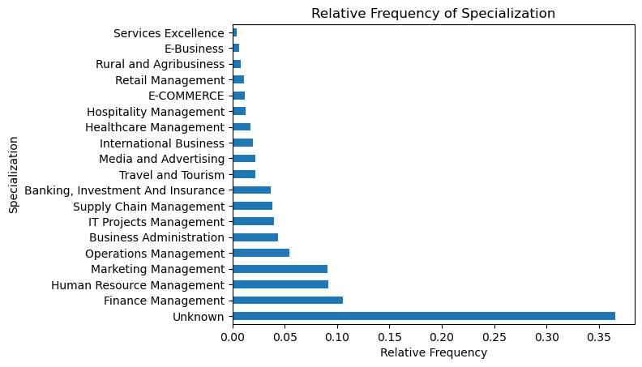
Specialization – Leads from unknown, Finance, HR and Marketing management are high frequency to convert

Slide 8
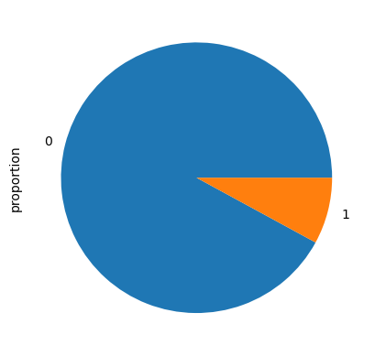
Categorical Ordered Univariate Analysis
An indicator variable selected by the customer wherein they select whether of not they want to be called about the course or not (No = 0, Yes =1).

Slide 9
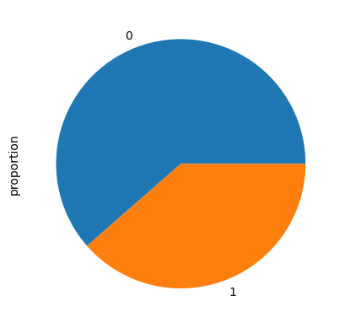
Categorical Ordered Univariate Analysis
Variable indicating whether a lead has been successfully converted or not (No = 0, Yes =1).

Slide 10
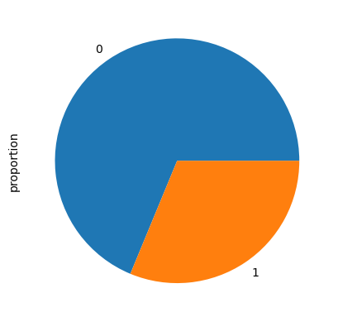
Categorical Ordered Univariate Analysis
Variable indicating whether the customer wants a free copy of 'Mastering the Interview' or not. (No = 0, Yes =1).

Slide 11
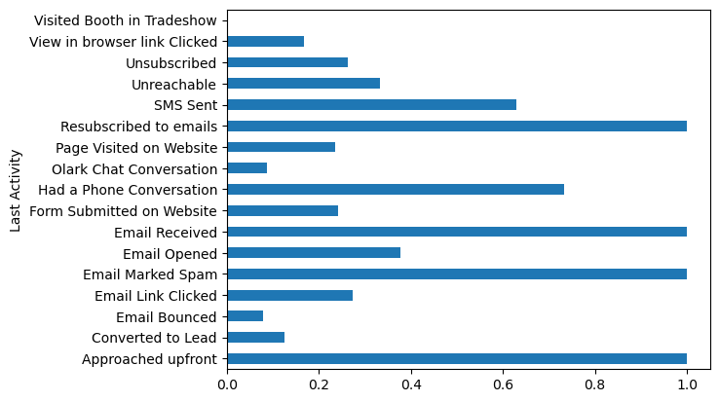
Last Lead Activity
From this graph we can see Emails, SMS and phone conversation have high convert rate.

Slide 12
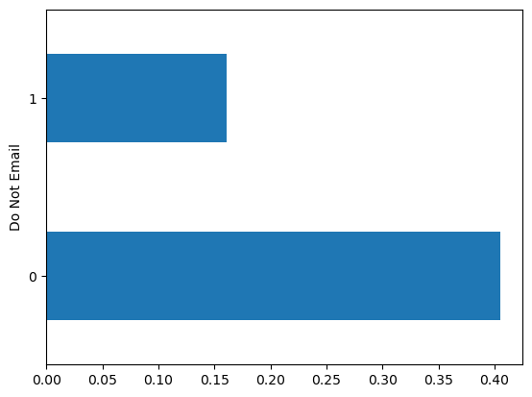
Do not Email
Most of peoples don’t want to receive email about courses.

Slide 13
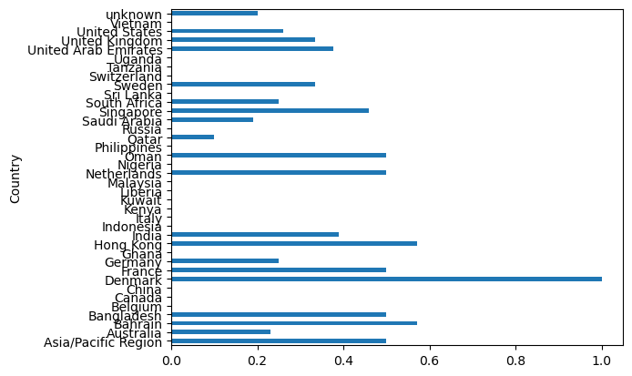
Where are Customers Coming from? Denmark, Bahrain and Hong Kong

Slide 14
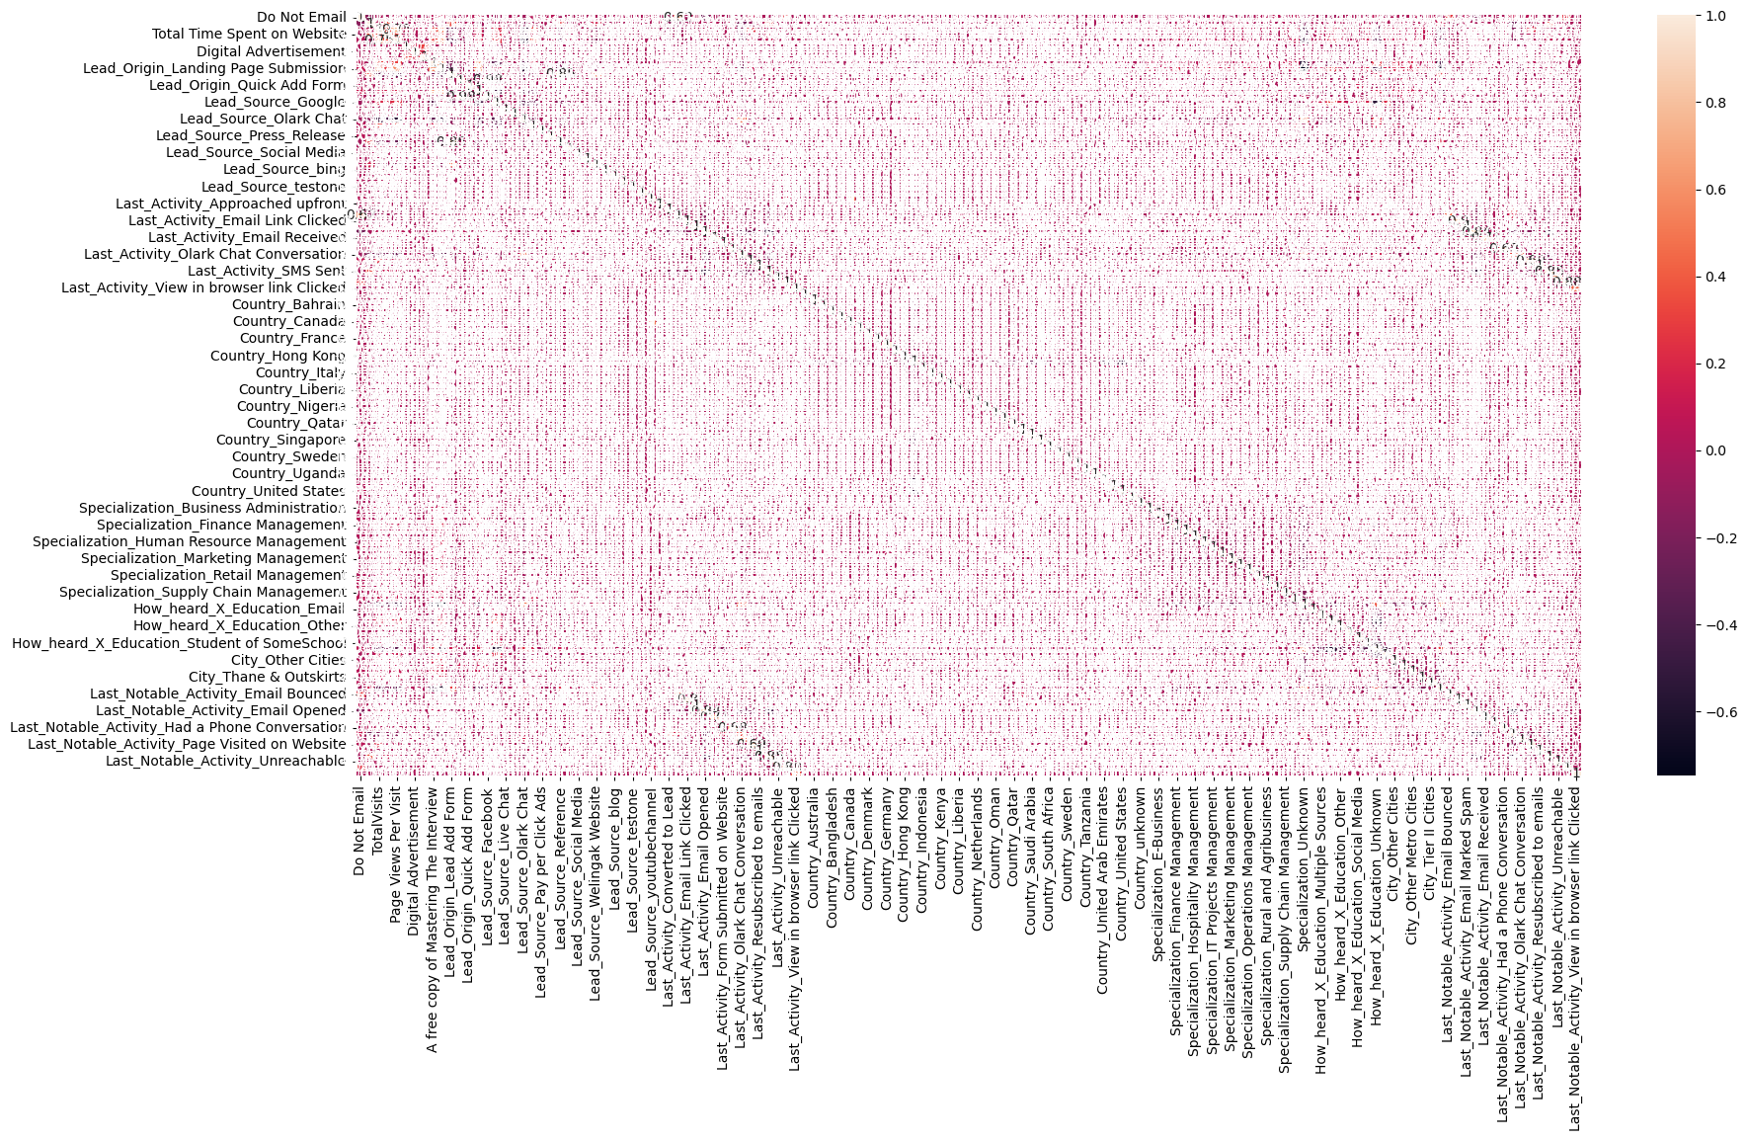
Correlation – there is no correlation between the variables

Slide 15
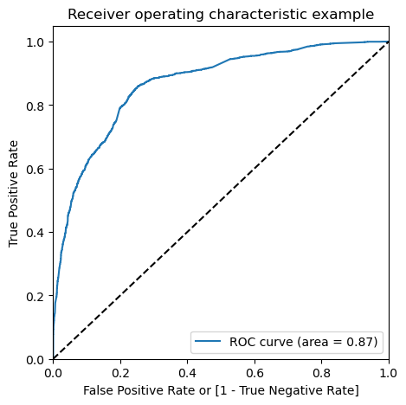
Model Evaluation – ROC Curve
The ROC curve measures how well a model can separate two classes. An AUC value of 0.87 means the model is very good at predicting which leads will convert. The AUC ranges from 0 to 1, where 0.5 is random guessing and 1 is perfect. A score of 0.87 shows the model has an 87% chance of correctly identifying converted and non-converted leads. This means the model balances True Positive Rate (sensitivity) and False Positive Rate well. Overall, the model is reliable and can help prioritize high-potential leads, making the sales process more efficient.

Slide 16

Our Observations
We used logistic regression to train the model with 15 selected features. After training, the model’s performance was evaluated on the training dataset, achieving an accuracy of 78.99%. This result indicates that the model is learning meaningful patterns from the data and provides a good starting point for further improvement.
On the test data, we experimented with different decision thresholds to optimize the model’s performance. Initially, a threshold of 0.42 resulted in an accuracy of 79.65%. We tested other thresholds, including 0.3, 0.4, and 0.5, and found that a threshold of 0.4 achieved the best accuracy of 80.45%. This improvement demonstrated that the model generalizes well to unseen data. The results suggest the model is not overfitting and can make reliable and accurate predictions on new leads.

Slide 17
Conclusion
Our approach focused on cleaning and analyzing lead data to predict conversions effectively. We used logistic regression to train the model with selected features. Key insights emerged from the graphs:
Country Analysis: Certain countries have higher lead conversion rates, indicating they should be prioritized. Especially customers from Denmark, Bahrain and Hong Kong.
Do Not Email: Most of clients prefer not to receive email, X education would like to explore different marketing mean.
Last Lead Activity: Features like “SMS Sent” and “Email Received” show strong associations with conversion.
Page Views and Visits: Outliers indicate some visitors are highly engaged but rare.
The model achieved a solid performance, identifying critical factors to prioritize high-potential leads efficiently.

Slide 18

The End

